Slide 1
MEDICINES INVENTORY MANAGEMENT SYSTEM
By Team Alpha:
Dhruv Sutail, Manav Vagdoda, Suraj Pandey

Slide 2
PROJECT DEFINITION
admin module:
for adding different medicines and related information can be add, update and remove.
manager module: can view available medicines and details also see the retail stores availability of medicines and demands for medicine
also sees the dispatch details of medicines.
retailer module: have to register as a retailer, create inventory details for their own shop, request dispatcher to ask for medicines and any other feedback.

Slide 3
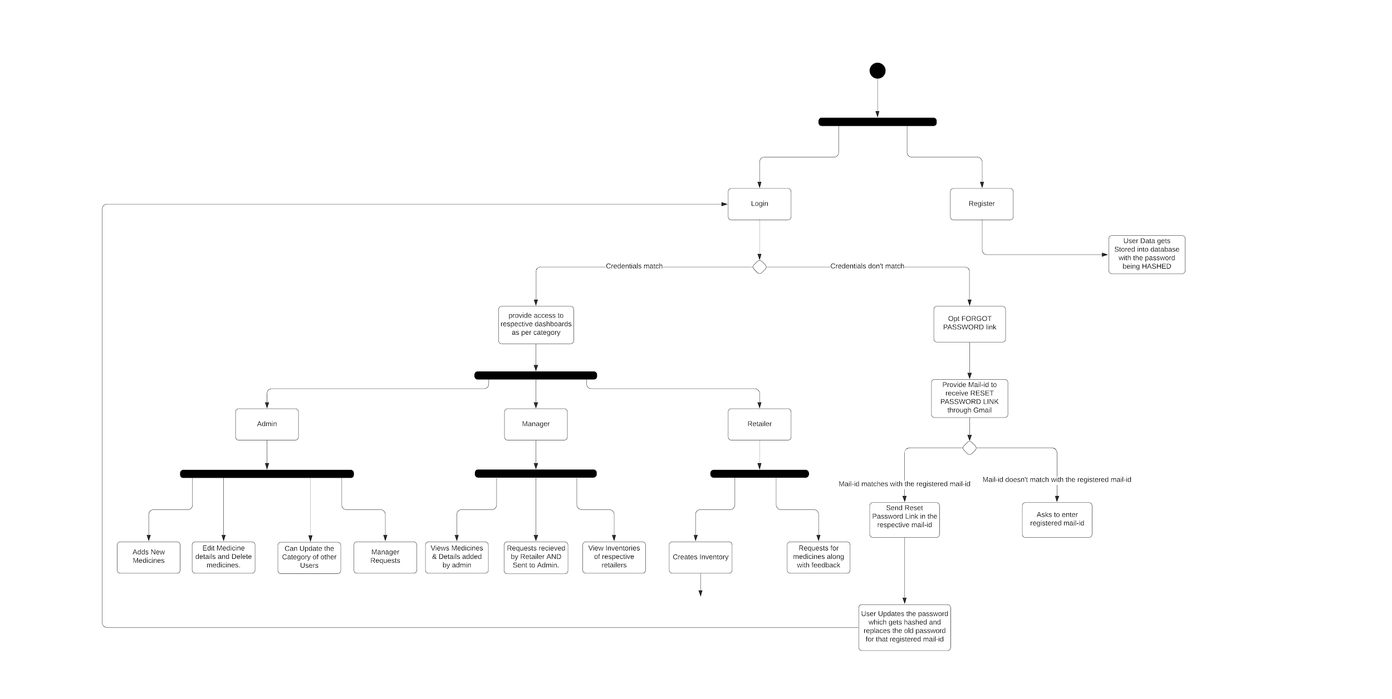
WORKFLOW

Slide 4
OTHER DETAILS...
APIs: 1) JAVA Mail API
2) MySQL Connector/J
Framework: Java beans activation framework.
Database: MySQL
IDE Details: Eclipse IDE, Visual Studio Code

Slide 5
KEY POINTS TO OUR WEB APPLICATION
We inherently wanted to build something that helps people in real world to solve problems at scale. We stumbled upon the idea of helping them manage their businesses in a much simpler way to increase efficiency and revenue as well. And what better way to do that than building a management system!
We have together built an inventory management system. This Web application will help people solve their issues of dealing with each and every aspect of variable change that happens in this business by allowing us to manage all of it with even more efficiency. We've development the system with medical inventory as the center.

Slide 6
THANK YOU

